Slide 1
Commonsense Causal Reasoning by Causal Relation Extraction from the Web
Mar 11th , 2015
Zhiyi Luo
jessieluo1991@gmail.com

Slide 2
Commonsense Casual Reasoning
Recognize causal relation and measure causal strength between two text spans, such as words, phrases and sentences.
Causal Pairs
Words:
think -> idea
Phrases:
get a job -> earn money
Sentences:
The sun was rising. -> My body cast a shadow over the grass.
Notes:
After solving this, we can answer:

Slide 3
Examples
Two types of causal reasoning
Type 1
Premise: The man broke his toe. What was the CAUSE of this?
Alternative 1: He got a hole in his sock.
Alternative 2: He dropped hammer on his foot.
Type 2
Premise: I tipped the bottle. What happened as a RESULT?
Alternative 1: The liquid in the bottle froze.
Alternative 2: The liquid in the bottle poured out.

Slide 4
Outline
Build commonsense causal knowledge base: CausalNet (term-based causal network).
Propose a causality metric to measure causal strength between terms : generalized causality PMI.
Design an algorithm framework to solve commonsense causal reasoning problem.
Notes:
How we solve the problem

Slide 5
CausalNet
Design strong causal cue patterns
“cause”, “lead to”, “because”…
Extract causal pairs (terms) from large web corpus
Build Weighted Graph: CausalNet
Node: term (word)
Edge: two directed edges exist between every two nodes
Weight: edges are weighted with causal strength

Slide 6
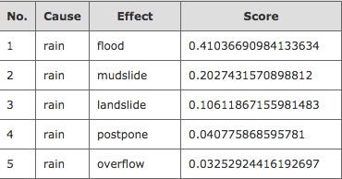
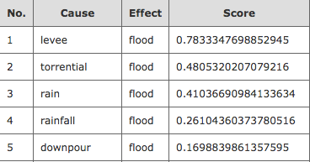

Slide 7

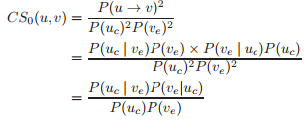

Causal Strength
PMI
(omit logarithm)
Causality PMI
Introduce cause role and effect role
Generalized Causality PMI
Introduce parameters
Notes:
This is actually the Causal Strength between two terms

Slide 8
Algorithm
Score Calculation
Light weighting pattern
Events Extraction
Weight Boosting
Combination

Slide 9
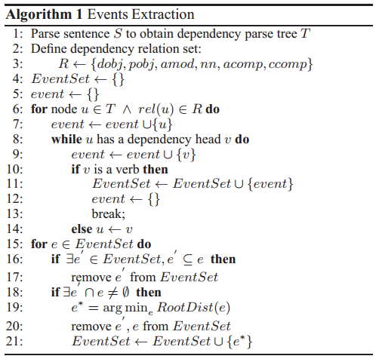
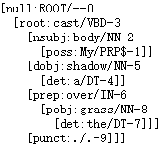
Events Extraction
Example
Sentence:
My body cast a shadow over the grass.
Dependency parsed tree
Events:
cast shadow

Slide 10
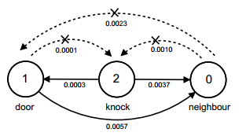
Weight Boosting
If we get event “knock neighbor door” from sentence “I knocked on my neighbor’s door.”
We make use of causal relation inner events to boost weights of particular terms.

Slide 11


Causal Score Calculation
Combination
The overall causal strength score from text T1 to text T2
is the weight after weight boosting for word w.
Penalty factor for the semantic ambiguity of u and v
Notes:
We now have causal strength between two terms. We design an algorithm to calculate causal score between any two spans.

Slide 12
Experiments
Investigate Causal Cue Patterns
End-to-end results on COPA
Investigate two Research Questions using ConceptNet 4

Slide 13
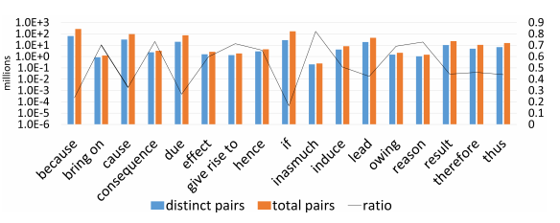
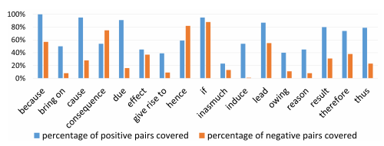
Causal cue patterns
We can group our causal cue patterns into 17 sets.
Notes:
The blue bars (left) are the number of distinct pairs and the orange one(right) show the total number of pairs. Inter-sentence cues like “if” and “because” harvested the largest number of pairs. But more specific patterns such as “reason” and “inasmuch” find more diverse pairs, since the number of distinct pairs is relatively large compared to the total pairs extracted.

Slide 14
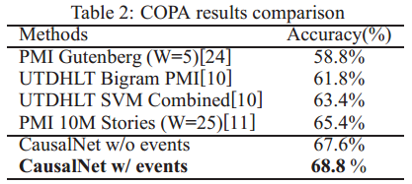
End-to-end Evaluation on COPA
Parameter setup
alpha = 0.4, beta = 0.3

Slide 15
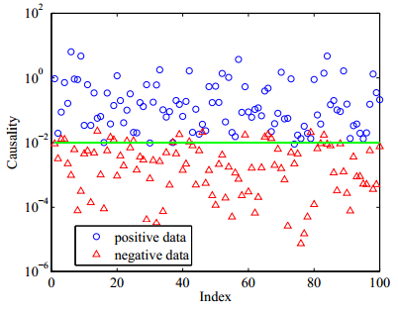

Investigate Research Questions
Investigate whether our proposed causality score clearly separates the causal/non-causal pairs.
When causal/non-causal pair sharing the same premise, and investigate the accuracy of our selection of positive alternative.

Slide 16
Online CausalNet
http://202.120.38.146/causal/

Slide 17
Thank you!

